Slide 1

Project Juniper
Notes:
Notes:
Strengths:
Strong delivery
Preferred engagement style
Graphics, Slides are easy to follow
User empathy with couriers
Recommendations: Prep Time is a key symptom of inefficiency
Areas of improvement:
Talk through 3 sides of marketplace. Discuss market place health in more detail – sandra
Add an exec summary (usually incldues recommendation)
Focus on experiment. include v2 of experiment
Add objective of this meeting - what do we want to do (alginment, decision making, etc). TLDR whats the recommendation? Whats our ask? (e.g. budget, headcount/resources)
Flow was long from insight to issue (condense insight slides)
What are other alternatives we considered? I.e what other levers could we pull to reduce wait times besides merchants?
Effort vs. impact could be condensed to 1 slide. What variables did we consider to “effort”(HC,cost,etc) and “impact” (ROI,etc)
1:1:1 ; data and insights, strategy and prioritization, GTM strategy
Presentation:
Add an exec sum
Recommends ~5-10 slides for 15 min
Give space for Q and A throughout - slowdown. Ask for reactions after large chunks
Crisp up and refine key metric slides

Slide 2
Executive Summary
Business
Context
How is the New York launch going?
Launch performance has been poor. We are seeing declines in daily new customers, returning customers, returning couriers, and high wait times for couriers at a variety of merchants
The
Problem
Couriers are leaving the platform
Courier engagement, retention, and efficiency is low and declining, and we believe the main culprit is high excessively high wait times at merchants
Our Recommendation
Create a "Juniper's Favorites" designation
In an effort to reward restaurants with faster prep times and increase their visibility, the “Juniper’s Favorites” designation will highlight restaurants with improved (15% reduction in wait time) or already fast (<10 mins) prep times
Proposed Implementation
2 week pilot in selected zones followed by scaling if successful
2 FTE Ops and 2 FTE Engineering resources required to conduct the pilot. If we see improvements in merchant wait times, order ratings, delivery time ratings, and courier retention, we can assess expanding the experiment to all zones and in app

Slide 3

Table of Contents
1
Launch Summary
2
Problem Statement
3
Courier Key Metrics
4
Proposal
5
Appendix

Slide 4
Launch Summary

Slide 5




Since NYC launch 5 weeks ago, Juniper has had…
898 Partnered Merchants
5214 Orders Delivered
(+5% average WoW change)
(+3% average WoW change)
578 Couriers
3192 Total Customers
(-50% daily new users since launch)
(-76% daily new couriers since launch)
Notes:
5214/35= ~153 orders a day

Slide 6
Problem Statement

Slide 7

Juniper is struggling with adequately supporting the market’s supply and demand
1
Customer Retention declines to ~60% after the second week
2
Daily New Users down 50% since launch
3
Worsening Courier Retention and Engagement
4
Revenue declining ~13% WoW for last two weeks
Our Focus: Understanding key courier metrics to improve courier satisfaction

Slide 8
Courier
Key Metrics

Slide 9
Courier Key Metrics
Courier Retention
Courier Engagement
Courier Efficiency
Long idle times at merchants is the key driver for worsening courier metrics
Notes:
Focusing on couriers - main focus for today’s project and experiment. Our team specifically wanted to focus on this side of the Juniper marketplace
We dug into three key metrics that we see as important benchmarks for overall health of our couriers - courier retention (how have our courier cohorts retained on juniper), courier engagement (once we get couriers on juniper, whats the frequency and depth in which they make deliveries) and courier efficiency (how many orders are couriers during active times).
After evaluating these three metrics -> hypothesis that long idle times for couriers waiting at merchants was the driver for poor courier health. Okay now I’ll deep dive into what these three metrics mean, and why theyre important.

Slide 10
Courier Retention
% Couriers that made a delivery
Cohort | Week 1 | Week 2 | Week 3 | Week 4 | Week 5
27/09/20 | 100% | 77% | 67% | 64% | 59%
04/10/20 | 100% | 60% | 52% | 42%
11/10/20 | 100% | 57% | 42%
18/10/20 | 100% | 47%
Courier retention declines to 60% during their 2nd week, and its decreasing with every new cohort
Notes:
First thing we looked at was courier retention.
40% of couriers leaving platform after their first week of deliveries - and this is getting worse with every new cohort. Weve seen week 2 cohort retention decline from 77% to 47% over the last 5 weeks. Additionally, not only is this worsening with every new cohort of couriers, but week over week retention declines ~8% on averaage. SO not only are our new cohorts getting worse, but existing cohorts continue to churn off the platform.
Pie chart data: https://docs.google.com/spreadsheets/d/1_iHeGIelN7HC9B5zWKSFcpRDXnntDq12bTUTNZ81Pmk/edit#gid=395336166
Pie chart sql source: https://redash.joinskillful.com/queries/636/source
Replace pie chart with double bar chart

Slide 11
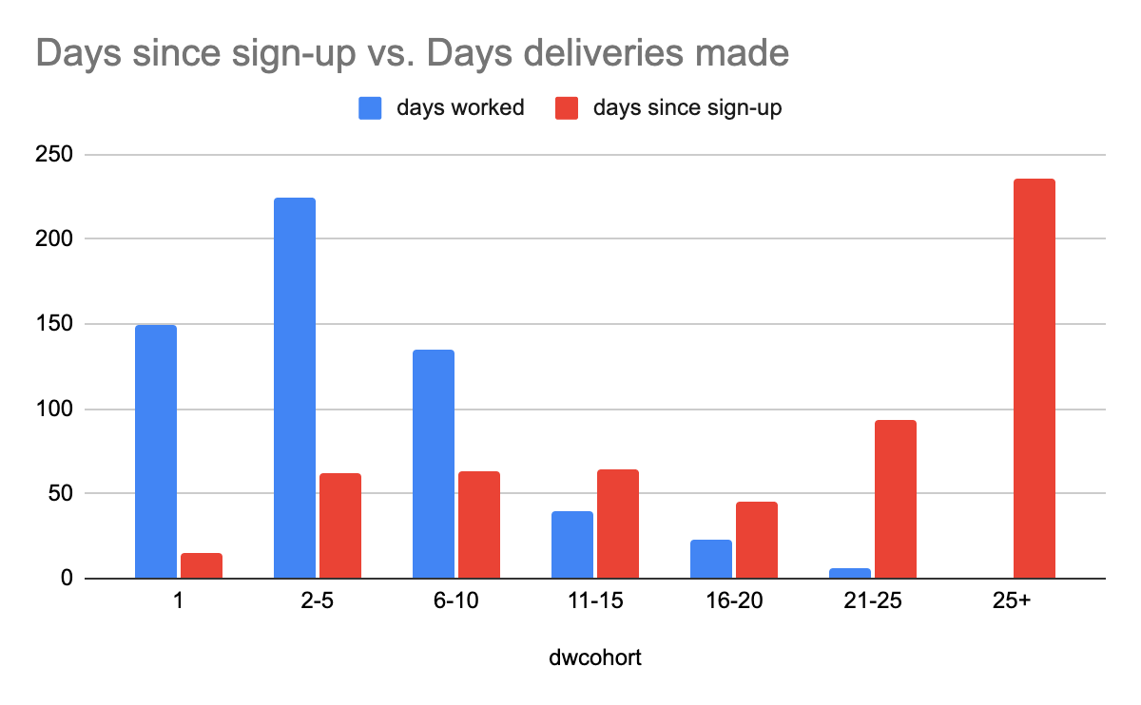
Courier Engagement
Although most Couriers have signed up for Juniper 25+ days ago, 25% have only worked 1 day and 50%+ have worked <5 days
Notes:
So we then tried to understand - for the couriers that sign up, whats the depth at which theyre making deliveries?
What we found
Over half of Couriers signed up 25+ days ago, but 50% have made 5 or less deliveries and 25% have made only one delivery.
Couriers even though most of them have signed up a while ago, are not actually making that many deliveries

Slide 12
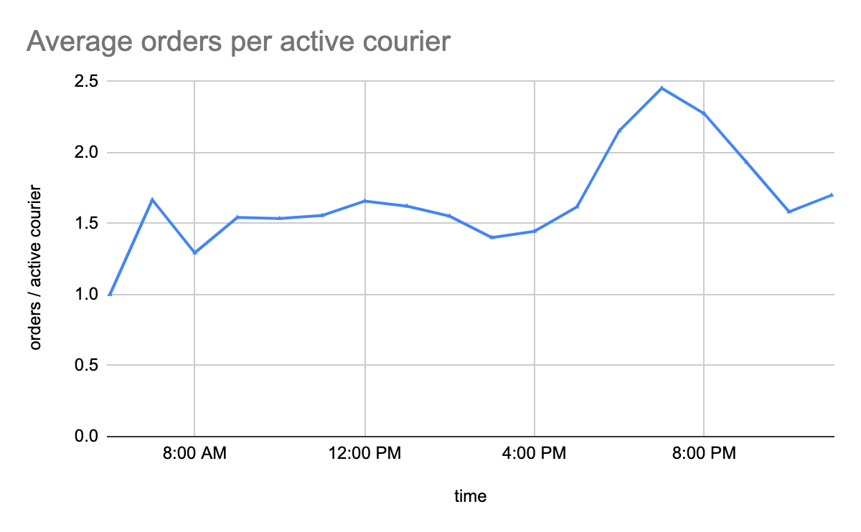
Courier Efficiency
Orders per active couriers ranges from 1 orders/hour during non-peak to 2.5 orders/hour during peak hours
If couriers only receive $4-6 in wages / delivery. This means even during peak hours, couriers earn less than NYC minimum wage
Time of Day
Notes:
When couriers are active, they’re not making high volumes of deliveries. Orders per hour / per active courier range from 1 during non peak to 2.5 during peak
This is a super low incentive for couriers.If couriers are only able to make $4-6 in wages for their delivery, this means that theyre barely scraping NYC minimum wage during peak dinner hours. And this bottleneck, we believe is because Couriers are wasting too much time at the merchant waiting for the food to be finished. Now ill pass it off to JAck to speak more
Right chart data: https://docs.google.com/spreadsheets/d/1_iHeGIelN7HC9B5zWKSFcpRDXnntDq12bTUTNZ81Pmk/edit#gid=1747152238
WITH tb1 AS
(SELECT extract(hour
FROM when_the_delivery_started) AS time_of_day,
delivery_id
FROM Skillful_Data.Project_Data
WHERE when_the_delivery_started IS NOT NULL
GROUP BY 1,
2)
SELECT CASE
WHEN time_of_day BETWEEN 1 AND 5
OR time_of_day > 22 THEN '11pm-5am'
WHEN time_of_day BETWEEN 6 AND 10 THEN '6am-10am'
WHEN time_of_day BETWEEN 11 AND 14 THEN '11am-2pm'
WHEN time_of_day BETWEEN 15 AND 17 THEN '3pm-5pm'
WHEN time_of_day BETWEEN 18 AND 22 THEN '6pm-10pm'
END AS timeframe,
count(DISTINCT tb1.delivery_id) num_orders,
count(distinct Courier_id) active_couriers,
avg(timestamp_diff(when_the_Courier_arrived_at_dropoff,when_the_delivery_started,MINUTE)) as avg_trip_duration,
avg(timestamp_diff(when_the_Courier_arrived_at_pickup,when_the_delivery_started,MINUTE)) as time_to_pickup,
avg(timestamp_diff(when_the_Courier_arrived_at_dropoff,when_the_Courier_arrived_at_pickup,MINUTE)) as time_to_dropoff
FROM Skillful_Data.Project_Data pd
JOIN tb1 ON tb1.delivery_id = pd.delivery_id
GROUP BY 1;
WITH tb1 AS
(SELECT extract(hour
FROM when_the_delivery_started) AS time_of_day,
delivery_id
FROM Skillful_Data.Project_Data
WHERE when_the_delivery_started IS NOT NULL
GROUP BY 1,
2)
SELECT CASE
WHEN time_of_day BETWEEN 1 AND 5
OR time_of_day > 23 THEN '12am-5am'
WHEN time_of_day = 6 THEN '6am'
WHEN time_of_day = 7 THEN '7am'
WHEN time_of_day = 8 THEN '8am'
WHEN time_of_day = 9 THEN '9am'
WHEN time_of_day = 10 THEN '10am'
WHEN time_of_day = 11 THEN '11am'
WHEN time_of_day = 12 THEN '12pm'
WHEN time_of_day = 13 THEN '1pm'
WHEN time_of_day = 14 THEN '2pm'
WHEN time_of_day = 15 THEN '3pm'
WHEN time_of_day = 16 THEN '4pm'
WHEN time_of_day = 17 THEN '5pm'
WHEN time_of_day = 18 THEN '6pm'
WHEN time_of_day = 19 THEN '7pm'
WHEN time_of_day = 20 THEN '8pm'
WHEN time_of_day = 21 THEN '9pm'
WHEN time_of_day = 22 THEN '10pm'
WHEN time_of_day = 23 THEN '11pm'
END AS timeframe,
count(DISTINCT tb1.delivery_id) num_orders,
count(distinct Courier_id) active_couriers,
avg(timestamp_diff(when_the_Courier_arrived_at_dropoff,when_the_delivery_started,MINUTE)) as avg_trip_duration,
avg(timestamp_diff(when_the_Courier_arrived_at_pickup,when_the_delivery_started,MINUTE)) as time_to_pickup,
avg(timestamp_diff(when_the_Courier_arrived_at_dropoff,when_the_Courier_arrived_at_pickup,MINUTE)) as time_to_dropoff
FROM Skillful_Data.Project_Data pd
JOIN tb1 ON tb1.delivery_id = pd.delivery_id
GROUP BY 1;

Slide 13

The Issue…
Excessively long wait times at restaurants means too much time spent waiting for couriers at restaurants, which decreases their time frame to make deliveries
Courier dissatisfaction; Poor courier retention, engagement, and efficiency;

Slide 14
Time spent waiting at the restaurant consists of 41% of total time between order receipt and delivery handoff
Couriers are waiting an average of 18.91 minutes at the merchant - this is 41% of the trip duration from the time the order was placed…
!
Time to Pick-up
Time at Merchant
Time to Drop-off
Time (Minutes)

Slide 15
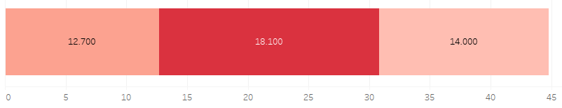
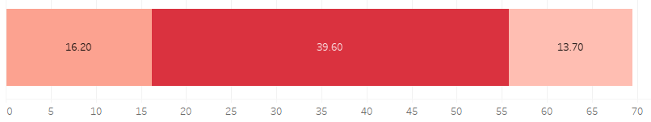
Average Duration by Merchant Type
Restaurant
We are seeing a bottleneck with wait times at both restaurants and non-restaurants
Non-restaurant
Notes:
Ultimately standardize decimals
Data: https://docs.google.com/spreadsheets/d/1_iHeGIelN7HC9B5zWKSFcpRDXnntDq12bTUTNZ81Pmk/edit#gid=1990418454
with R as (
SELECT
'resturant',
COUNT (DISTINCT pd.delivery_id) num_orders,
avg(total) avg_total,
avg(r.total_rating) avg_total_rating,
avg(timestamp_diff(when_the_Courier_arrived_at_pickup,when_the_delivery_started,MINUTE)) AS time_to_pickup,
avg(timestamp_diff(when_the_Courier_left_pickup,when_the_Courier_arrived_at_pickup,MINUTE)) AS wait_time_merchant,
avg(timestamp_diff(when_the_Courier_arrived_at_dropoff,when_the_Courier_left_pickup,MINUTE)) AS time_to_dropoff,
avg(timestamp_diff(when_the_Courier_arrived_at_dropoff,when_the_delivery_started,MINUTE)) as trip_duration
FROM Skillful_Data.Project_Data pd
LEFT JOIN Skillful_Data.Ratings r ON pd.delivery_id = r.delivery_id
where place_category in ('BBQ',
'Deli',
'Thai',
'Asian',
'Donut',
'Pizza',
'Promo',
'Steak',
'Sushi',
'Vegan',
'Bakery',
'Burger',
'African',
'Chinese',
'Dessert',
'Italian',
'Mexican',
'Seafood',
'American',
'Japanese',
'Southern',
'Fast Food',
'Ice Cream',
'Vegetarian',
'Vietnamese',
'Mediterranean',
'Eastern European',
'Salad',
'Coffee',
'Indian',
'Drug Store',
'Shop',
'South American',
'French',
'Breakfast',
'Juice Bar',
'Russian',
'Middle Eastern',
'Spanish',
'Caribbean',
'Gluten-Free',
'German',
'Food Truck',
'Korean',
'Restaurant'))
,NR as (
SELECT
'non-resturant',
COUNT (DISTINCT pd.delivery_id) num_orders,
avg(total) avg_total,
avg(r.total_rating) avg_total_rating,
avg(timestamp_diff(when_the_Courier_arrived_at_pickup,when_the_delivery_started,MINUTE)) AS time_to_pickup,
avg(timestamp_diff(when_the_Courier_left_pickup,when_the_Courier_arrived_at_pickup,MINUTE)) AS wait_time_merchant,
avg(timestamp_diff(when_the_Courier_arrived_at_dropoff,when_the_Courier_left_pickup,MINUTE)) AS time_to_dropoff,
avg(timestamp_diff(when_the_Courier_arrived_at_dropoff,when_the_delivery_started,MINUTE)) as trip_duration
FROM Skillful_Data.Project_Data pd
LEFT JOIN Skillful_Data.Ratings r ON pd.delivery_id = r.delivery_id
where place_category in ('Grocery Store',
'Convenience Store',
'Specialty Store',
'Kids & Baby',
'Office Supplies Store',
'Department Store',
'Electronics Store',
'Beauty Supply',
'Art Store',
'Pet Supplies Store',
'Book Store',
'Clothing'))
select *
from R
union all
select *
from NR

Slide 16
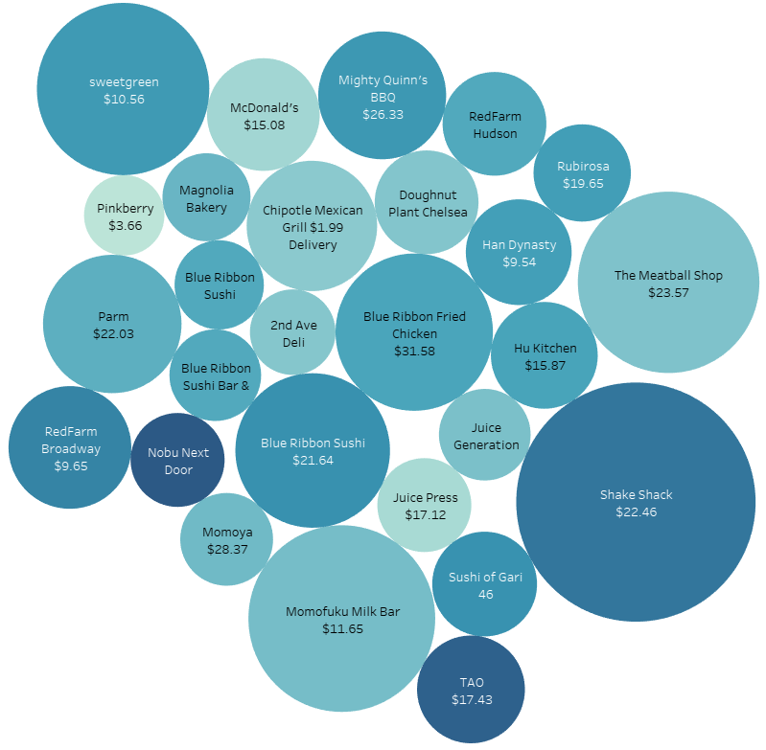

Restaurant Analysis
So what?
Juniper’s delivery volume is dominated by 4-5 key merchants (Shake Shack, Sweetgreen, Momofuku Milk bar, The Meatball Shop) that have average wait times >15+ minutes
- Bubble size indicates total number of orders (displaying merchants with >30 orders)
- Bubble color indicates wait times (darker bubbles show higher wait times)
- Text shows average order total
Notes:
--restaurants, orders, total, rating, durations
SELECT DISTINCT pickup_place,
place_category,
COUNT (DISTINCT pd.delivery_id) num_orders,
avg(total) avg_total,
avg(r.total_rating) avg_total_rating,
avg(timestamp_diff(when_the_Courier_arrived_at_pickup,when_the_delivery_started,MINUTE)) AS time_to_pickup,
avg(timestamp_diff(when_the_Courier_left_pickup,when_the_Courier_arrived_at_pickup,MINUTE)) AS wait_time_merchant,
avg(timestamp_diff(when_the_Courier_arrived_at_dropoff,when_the_Courier_left_pickup,MINUTE)) AS time_to_dropoff,
avg(timestamp_diff(when_the_Courier_arrived_at_dropoff,when_the_delivery_started,MINUTE)) as trip_duration
FROM Skillful_Data.Project_Data pd
LEFT JOIN Skillful_Data.Ratings r ON pd.delivery_id = r.delivery_id
GROUP BY 1,
2
ORDER BY 3 DESC;

Slide 17
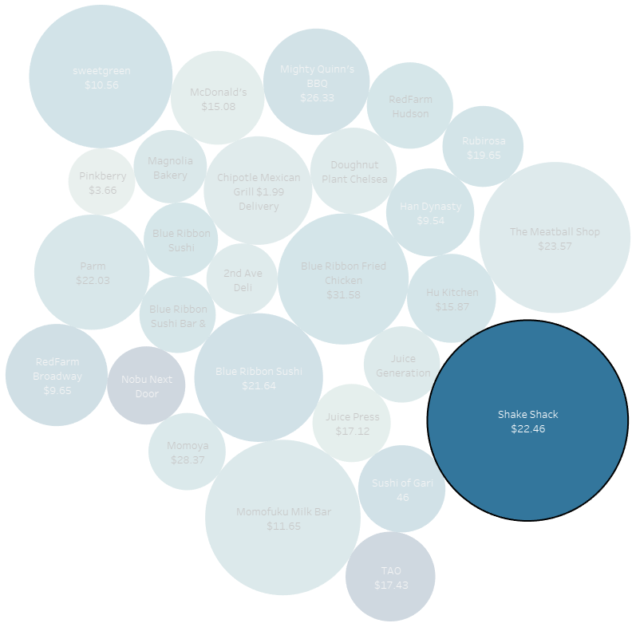
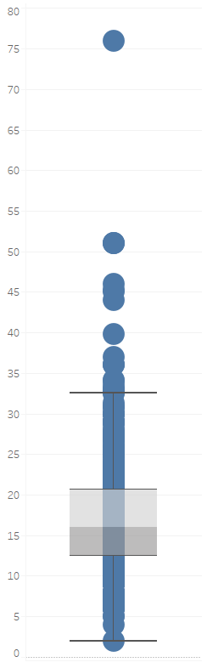
Restaurant Case Study - Shake Shack
Shake Shack was most popular restaurant during the launch, accounting for ~5% of all order volume (with an average order total of $22.46), but the average wait time for couriers at the merchant was 23.70 minutes
This is unusually high for a fast casual restaurant - what are some potential ways we can lower wait times at merchants like these?
Average Wait Time at Merchant (Minutes)
Shake Shack time waited at merchant = 23.70 minutes
Median time waited at merchant = 16 minutes

Slide 18
Proposal

Slide 19

We want to improve Merchant Prep Time to reduce courier idling and improve courier retention
Notes:
With indication that prep time is causing courier dissatisfaction…we want to improve merchant prep time to reduce courier idling and improve courier retention

Slide 20




Possible Experiments
Experiment | Action Plan
 | Offer rebate program to restaurants if they prep food within given time window
 | Reward restaurants that make more than X% of on-time food handoffs with merchant visibility
 | Create software to optimize courier dispatch based on average merchant delay in prep time before food ETA
 | Quests within the app to incentivize couriers ($X bonus for X number of deliveries finished)
Notes:
To address the issue, we have thought of 4 possible experiments..a rebate program, a ploy for merchant visibility, software to optimize courier dispatch, and quests to incentivize couriers

Slide 21
Decision Matrix
HIGH EFFORT
4
3
1
LOW IMPACT
HIGH IMPACT
2
LOW EFFORT
Notes:
With Juniper being early stage, we plotted our experiments on an Impact vs. Effort matrix… ultimately deciding that we should seek improvement without shoveling a ton of money and resources into an experiment that may inevitably be a bust.

Slide 22
Decision Matrix
HIGH EFFORT
4
3
1
LOW IMPACT
HIGH IMPACT
2
LOW EFFORT
Notes:
Ultimately, experiment number 2, the merchant visibility experiment proved among the highest impact with the lowest effort. So let’s get into how the experiment actually would run.

Slide 23
Selected Experiment- #2
Hypothesis | Rewarding fast merchant prep times with greater marketing will incentivize merchants to expedite prep times and in turn, improve courier retention
Goal | Decrease courier idle time at restaurants by ~15% (down ~5 mins)
Tactics | “Juniper’s Favourites” section created to highlight Merchants with improved prep-times, experiment sending test comm to proof idea before building out
Targeting | SoHo- medium sized delivery area to test experiment before scaling to larger with ~100 merchants (10% of Juniper’s merchant base)
Control group | Restaurants in SoHo: qualify if prep time <10 minutes or prep time is reduced by 15% for “Juniper’s Favorites” placement
Impact | Couriers have to wait 18 minutes on average at pick-up locations due to a bottleneck in Merchant preparations. This is resulting in long delivery times, poor courier retention, and poor courier efficiency. Improving idle time will improve delivery time, retention, and efficiency.
Notes:
Sample size about 100 merchants or 10%. What % of merchants do we think will participate/be impacted by this program..

Slide 24
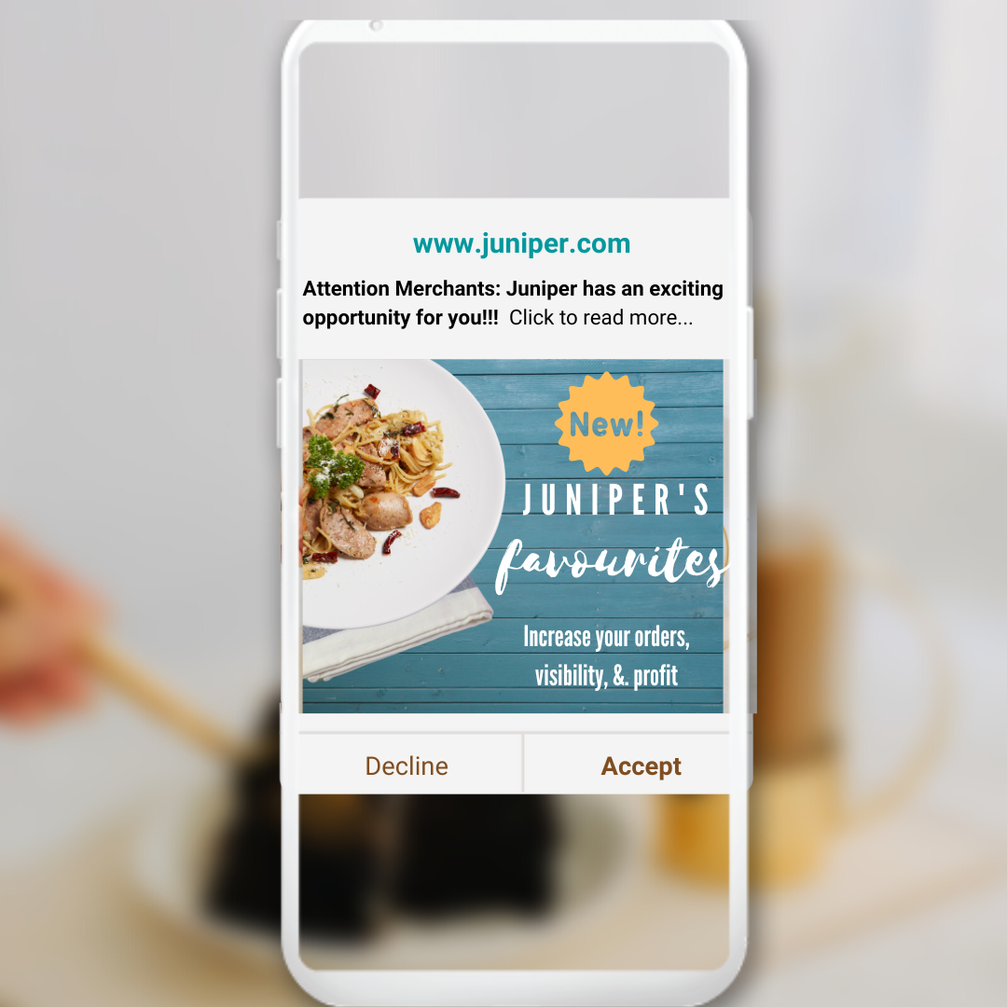
Experiment Overview
Comm sent to merchants with information about new highlight, based on tentative improvement– will be built out in app
Marketing:
Finalizing and sending Merchant Program via push notification
Ops :
Logic “Juniper Favorites” qualification
Answer support questions to Merchants on program
Send FAQ pop up to Merchants on their app, with program info
Notes:
Product Marketing:
Emails and Push notifications have a high bounce rate.
Short graphic - Merchant clicks “I accept” like a T&C–

Slide 25
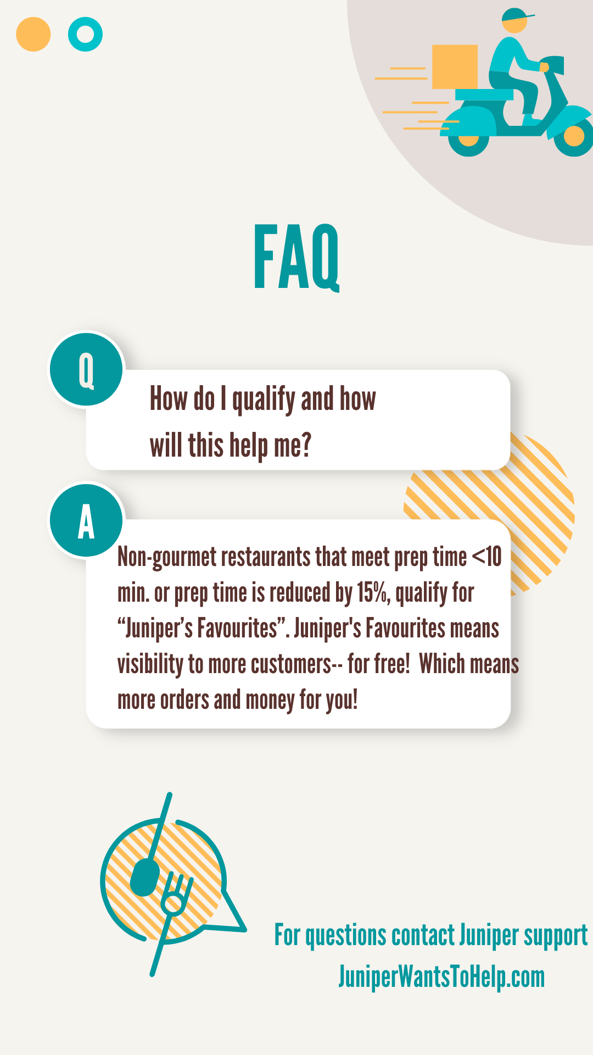
Example of FAQ page

Slide 26
Timeline- 2 weeks
 | Week 1 |  |  |  |  |  |  | Week 2
Team/Task | 1 | 2 | 3 | 4 | 5 | 6 | 7 | 8 | 9 | 10 | 11 | 12 | 13 | 14
Marketing: Create pop up and FAQ email to Merchants |  |  |  |  |  | X | X
Ops: Prepare qualification logic |  |  |  |  |  | X | X
Ops: Send pop up and FAQ email to Merchants |  |  |  |  |  | X | X
Support and Ops: Monitor for merchant inbounds |  |  |  |  |  | X | X
Company: Launch test |  |  |  |  |  | X | X
Company: Assess success |  |  |  |  |  | X | X
Notes:
Expand on logic for geolocation, and qualification (will be built out on slide 24)
Separate implementation from experiment. SiJia’s suggestion is just doing pop up
If experiment is just prep time, focus only on prep time. Try to cut geolocation, and minimize eng work. Eng work would be a second step after scaling.
On slide 24, would be cool to see a mockup of notification
Cross functional support needed:
Ops -
logic for dynamic geolocation based on Merchant and Customer location and “Juniper Favorites” qualification
Answer support questions to Merchants on program
Send FAQ pop up to Merchants on their app
Eng - connecting ops logic to “Juniper’s Favorites” placement

Slide 27
Measuring Success
KPIS
15% improvement in Merchant Wait Times
Total Rating; from average of 3.0 to 4.0
Courier Retention; from 55% to 65%
Guardrail Metrics: Merchant Retention, Food Quality Rating, Merchant order cancellations
Stakeholders
Sales: manage relationship with merchants
Ops: Create and push FAQ and handle merchant inquiries
Marketing: FAQ email and popup
All hands: Make priority 0, aid where necessary, assist in assessing launch
Risks & Mitigation
Risk: Displacing in-app visibility from advertising or promotional revenue
Mitigation:Create a different section to capture paid placements and prioritize based on tiers
Notes:
Guardrail Metrics– neutral

Slide 28
Scalability & Feasibility
Roll out to existing medium sized zones across NYC (Kips Bay, Hudson Sq)
Finalized all NYC zone roll out plus in app launch
START of week 3
MIDDLE of week 3
START of week 4
END of week 4
Roll out to existing smallest zones across NYC (Chinatown, Bedford) + ENG Implementing in app
Roll out to existing largest sized zoned in NYC (East Village,TriBeCa)

Slide 29
Appendix

Slide 30
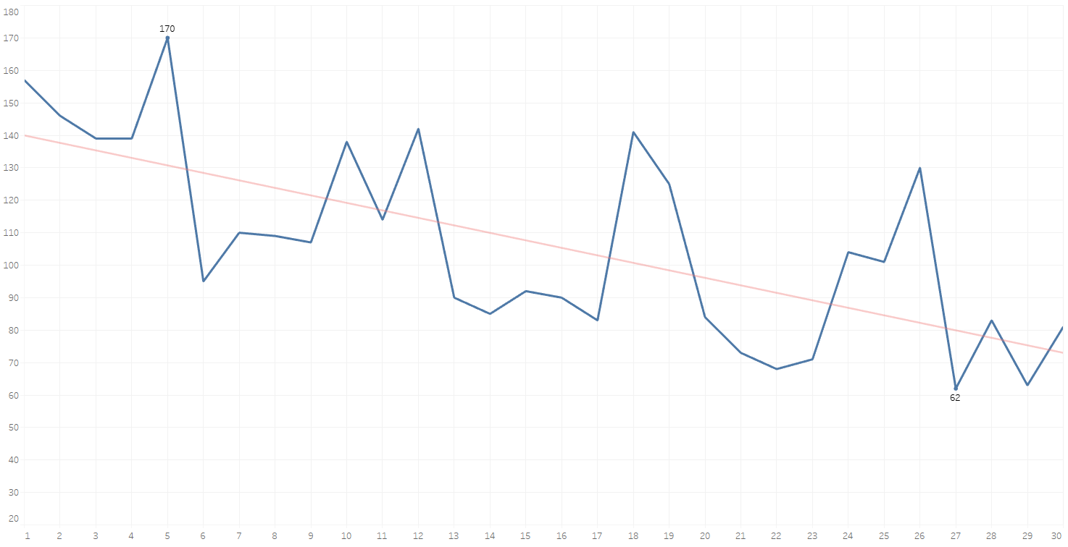
Appendix: Daily new users steadily declined during the launch
Notes:
WITH tb1 as
(SELECT DISTINCT customer_id, extract(MONTH
FROM min(when_the_delivery_started)) MONTH, extract(DAY
FROM min(when_the_delivery_started)) DAY
FROM Skillful_Data.Project_Data
GROUP BY 1)
SELECT tb1.Month,
tb1.day,
COUNT (DISTINCT tb1.customer_id) new_customers
FROM Skillful_Data.Project_Data pd
JOIN tb1 ON tb1.customer_id = pd.customer_id
GROUP BY 1,
2
ORDER BY 2;

Slide 31
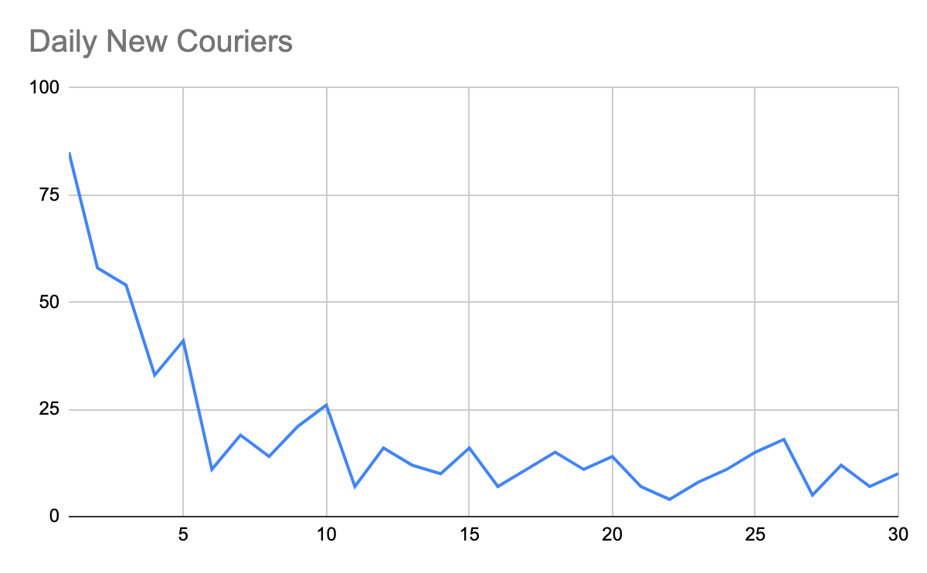
Appendix: Daily new couriers declined since launch
Notes:
WITH tb1 as
(SELECT DISTINCT customer_id, extract(MONTH
FROM min(when_the_delivery_started)) MONTH, extract(DAY
FROM min(when_the_delivery_started)) DAY
FROM Skillful_Data.Project_Data
GROUP BY 1)
SELECT tb1.Month,
tb1.day,
COUNT (DISTINCT tb1.customer_id) new_customers
FROM Skillful_Data.Project_Data pd
JOIN tb1 ON tb1.customer_id = pd.customer_id
GROUP BY 1,
2
ORDER BY 2;

Slide 32
Appendix: Customer Cohort Analysis
Key Insights:
Our ability to retain customers in Week 2 is declining: Week 2 retention has declined from 27% to 13% in L4W
We see the largest decline in WoW retention from Weeks 1 to Weeks 2: On average, 80% of our starting cohort churns between Week 1 and Week 2
Retention week over week is declining: After Week 2, we lose ~2% of our cohort each week
What we know (link):
Correlation between Total Rating and Customer Retention -> on average, if the customer’s first order is ratings 4 or 5, they have ~5% better WoW retention vs. ratings 1,2 and 3.
Cohort Week | Week 1 | Week 2 | Week 3 | Week 4 | Week 5
10/25/2020 | 100.0%
10/18/2020 | 100.0% | 13.4%
10/11/2020 | 100.0% | 17.5% | 13.1%
10/4/2020 | 100.0% | 19.1% | 18.8% | 16.1%
9/27/2020 | 100.0% | 26.5% | 25.8% | 26.9% | 23.3%
Notes:
Where to dig into - customer rating, location,

Slide 33
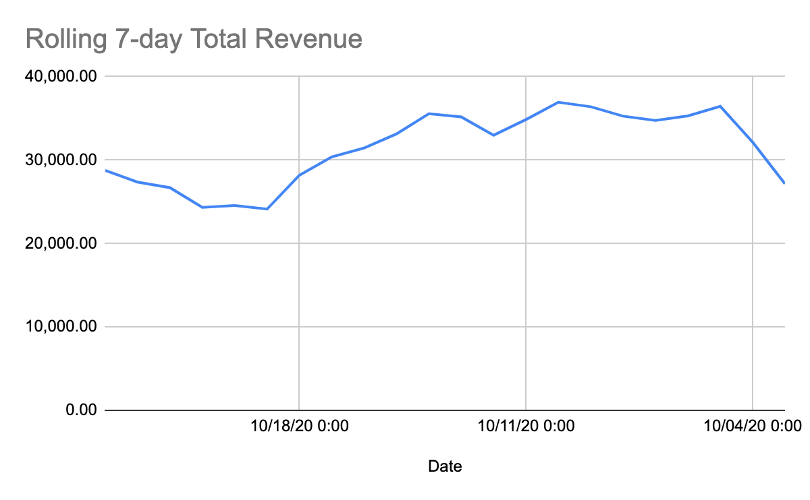
Appendix: L7D Total Revenue

